Slide 1
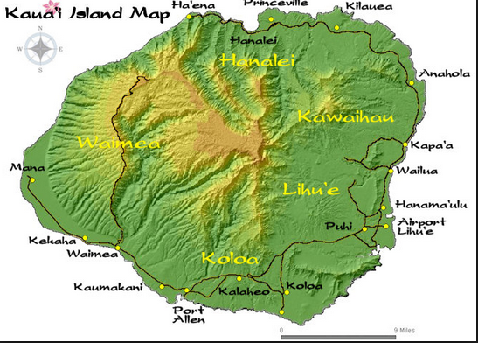
Kauai Island Themed-tour
Themes:
Hula Dance
Spiritual
Personal
Hai’ena
Beach
Hula
Hanalei
Farm
Kilauea Herb Garden
Anahola
Farm /School
Koke’e Mountain Lodge
Kealia
Farm

Slide 2

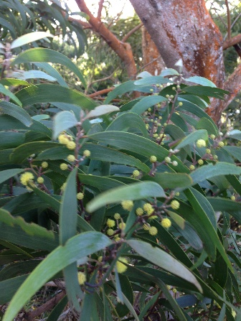
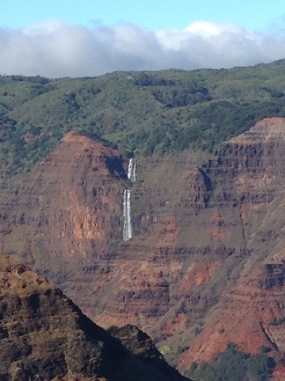
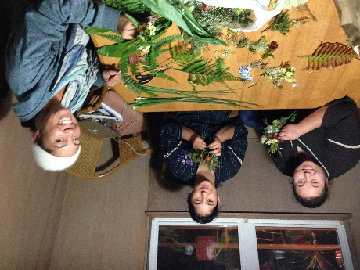
Koke’e Mountain Lodge
Kauai Island Themed-tour
Themes:
Hula Dance
Spiritual
Personal
Koke’e Mountain Lodge (10 to 15 people accommodation)
Your own kitchen and Food of your own liking
Enjoy Japan-like spring climate all year around
Excursion to Na Pali view and hiking as well as XXX Waterfall
Flower picking and lei making lessons

Slide 3
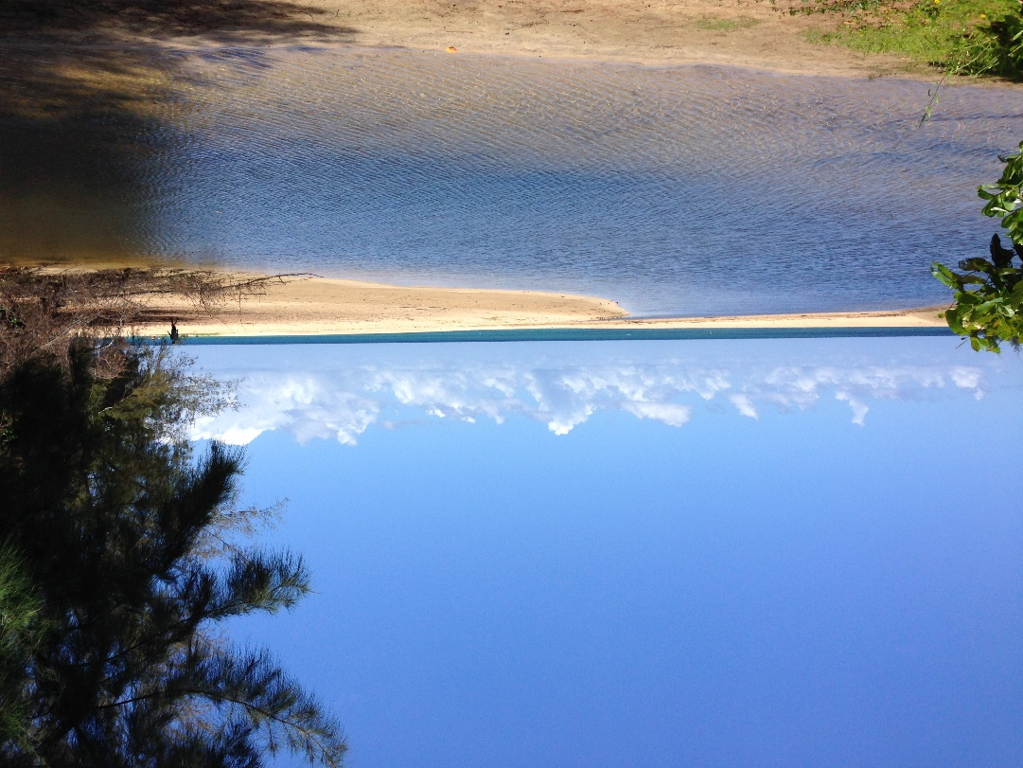
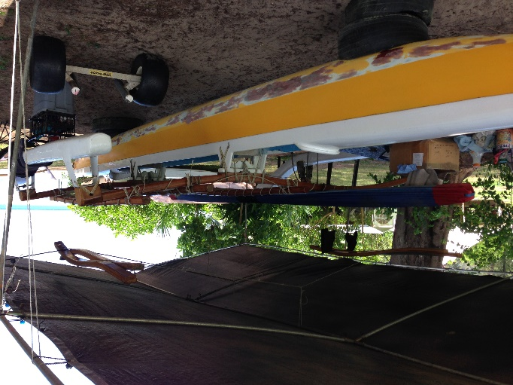
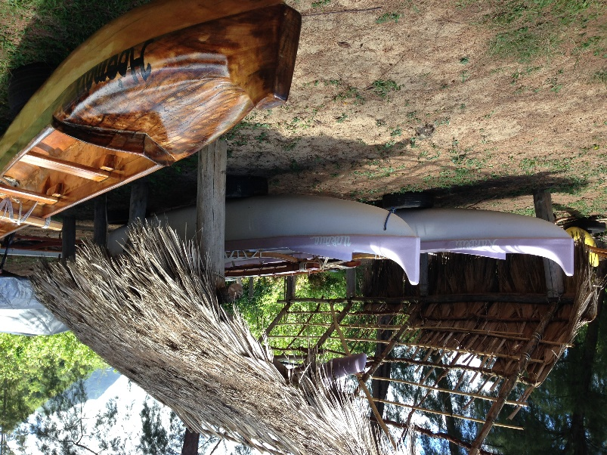
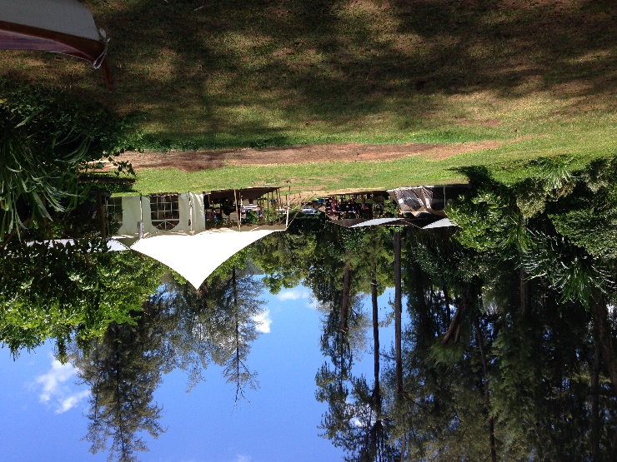
Hai’ena Beach Hula and Lodge
Kauai Island Themed-tour
Themes:
Hula Dance
Spiritual
Personal
Hai’ena Beach Hula and Lodge ( )
XXXX
XXXXXX and Food o

Slide 4
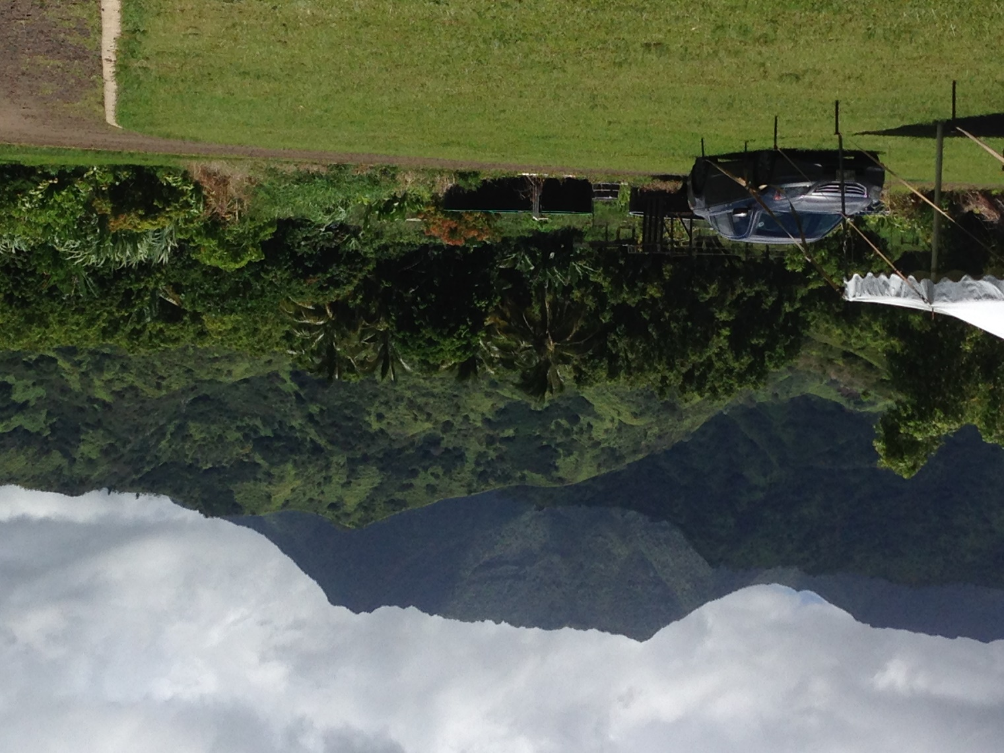
Hanalei Farm
Kauai Island Themed-tour
Themes:
Hula Dance
Spiritual
Personal
Hanalei Farm (10 to XXXXXXX

Slide 5
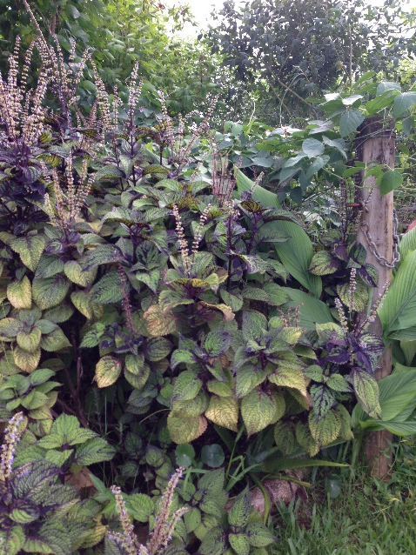
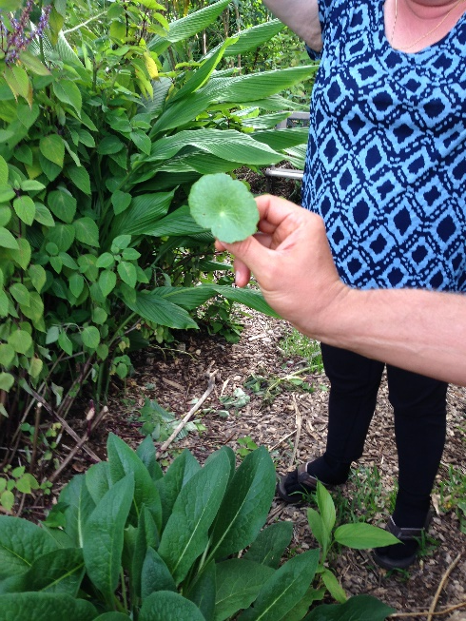
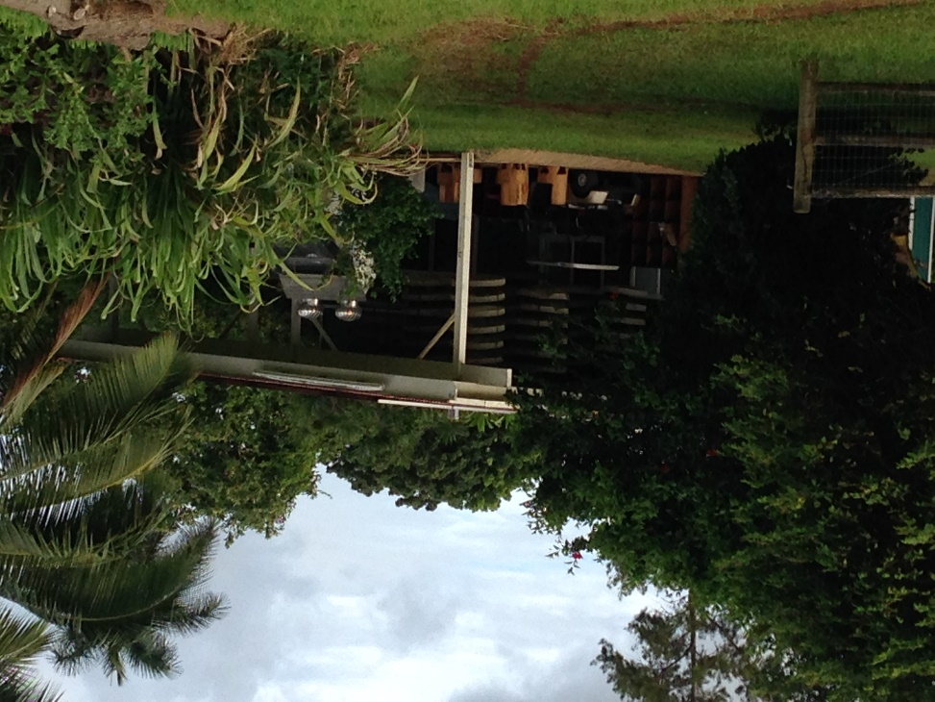
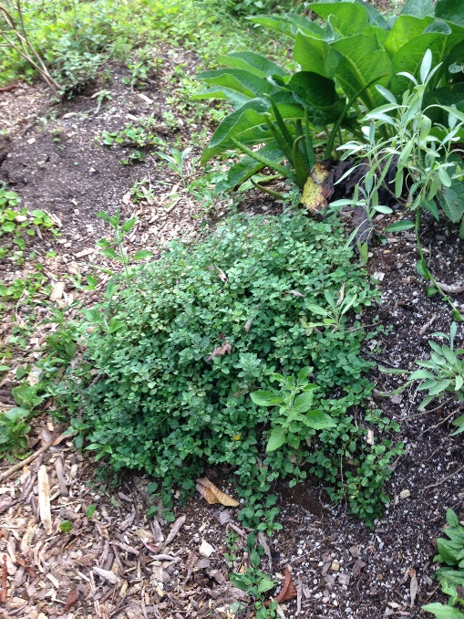
Kilauea Herb Garden
Kauai Island Themed-tour
Themes:
Hula Dance
Spiritual
Personal
Kilauea Herb Garden (10 to XXXXXXX

